Slide 1


Noida Institute of Engineering and Technology, Greater Noida
Biodiversity Succession
Unit -III
Subject Name
Environmental Science
Mrs. Sonali Agarwal
Assistant Professor
Civil Department
Course Details Semester –III/IV

Slide 2
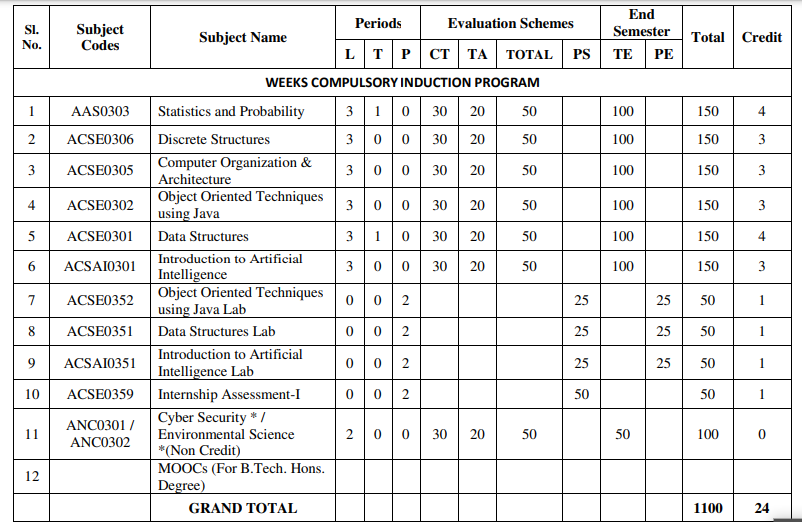
Evaluation Scheme

Slide 3
Syllabus
UNIT-I (Basic Principle of ecology)
Definition, Scope and basic principles of ecology and environment. Ecosystem: Basic concepts, components of ecosystem.
Food chains and food webs. Ecological pyramids, Energy flow in ecological systems, Characteristics of different ecosystems.
Biogeochemical Cycles: Importance, gaseous and sedimentary cycles. Carbon, Nitrogen, Phosphorus and Sulphur Cycles.
Basic concepts of sustainable development, SDGs, Ecosystem services, UN Decade for Eco restoration.

Slide 4
Syllabus
UNIT-II (Natural Resources and Associated Problems)
Natural resources and associated problems.
Forest resources: Use and over-exploitation, deforestation. Timber extraction, mining, dams and their effects on forest and tribal people.
Mineral resources: Use and exploitation, environmental effects of extracting and using mineral resources.
Food resources: World food problems, changes caused by agriculture and over-grazing, effects of modern agriculture, fertilizer-pesticide problems, water logging, salinity.
Land resources: Land as a resource, land degradation, man induced landslides. Equitable use of resources for sustainable lifestyles.
Non Renewable Energy Resources: Fossil fuels and their reserves, Nuclear energy, types, uses and effects,
Renewable Energy Resources: hydropower, Solar energy, geothermal, tidal and wind energy, Biomass energy, biogas and its advantages.

Slide 5
Syllabus
UNIT-III (Biodiversity Succession)
Biodiversity and their importance, Threats to biodiversity, major causes, extinction’s, vulnerability of species to extinction, IUCN threat categories, Red data book.
Strategies for biodiversity conservation, principles of biodiversity conservation in-situ and ex-situ conservation strategies,Mega diversity zones and Hot spots, concepts, distribution and importance.
Succession: Concepts of succession, Types of Succession. Trends in succession. Climax and stability.

Slide 6
Syllabus
UNIT-IV (Pollution and Solid Waste Management)
Air pollution: sources of air pollution, Primary and secondary air pollutants. Origin and effects of SO_{X}, NO_{X}, CO_{X}, CFC’s, Hydrocarbon,, control of air pollution.
Water pollution: sources and types of water pollution, Effects of water pollution, Eutrophication,
Soil pollution: Causes of soil pollution, Effects of soil pollution
Noise Pollution: Major sources of and effects of noise pollution on health,
Radioactive and thermal pollution: sources and their effects on surrounding environment.
Solid waste disposal and its effects on surrounding environment
Climate change, global warming, acid rain, ozone layer depletion,

Slide 7
Syllabus
UNIT-V (Role of Community and Environmental Protection Acts)
Role of community, women and NGOs in environmental protection, Bioindicators and their role, Natural hazards, Chemical accidents and disasters risk management,
Environmental Impact Assessment (EIA)
Salient features of following Acts:
a. Environmental Protection Act, 1986, Wildlife (Protection) Act, 1972.
b. Water (Prevention and control of pollution) Act, 1974.
c. Air (Prevention and control of pollution) Act, 1981. Forest (Conservation) Act, 1980.
d. Wetlands (Conservation and Management) Rules, 2017;
e. Chemical safety and Disaster Management law.
f. District Environmental Action Plan. Climate action plans.

Slide 8
Applications for Emerging Technology
Environmental engineering is the application of science and engineering principles to improve the environment (air, water, and/or land resources), to provide healthful water, air, and land for human habitation and for other organisms, and to remediate polluted sites.

Slide 9
Course Objectives(CO1)
To help the students in realizing the inter-relationship between man and environment and help the students in acquiring basic knowledge about environment.
To develop the sense of awareness among the students about environment and its various problems.
To create positive attitude about environment among the student.
To develop proper skill required for the fulfillment of the aims of environmental education and educational evaluations
To develop the capability of using skills to fulfill the required aims, to realize and solve environmental problems through social, political, cultural and educational processes

Slide 10
Course Outcome
CO 1 | Understand the basic principles of ecology and environment. Ecosystem: Basic concepts, components of ecosystem, food chains and food webs. Ecological pyramids | K1,K2
CO 2 | Understand the different types of natural recourses like food, forest, Minerals and energy and their conservation | K1.K2
CO 3 | Understand the importance of biodiversity, Threats of biodiversity and different methods of biodiversity conservation. | K1,K2
CO 4 | Understand the different types of pollution, pollutants, their sources, effects and their control methods. | K1,K2,K3
CO 5 | Understand the basic concepts of sustainable development, Environmental Impact Assessment (EIA) and different acts related to environment | K1,K2,K3

Slide 11

Topic mapping with CO
Topic | Topic outcome | CO Map | Extend of mapping
Environment and its segment | Students understand the meaning of environment | CO1 | 1
Segment of atmosphere Multidisciplinary nature of EVS Scope and importance of evs | .Students understand different segment of atmosphere Students understand the basic knowledge of basic science Students understand the scope of environmental SC. | CO1 | 1
Food chain and food web | Students understand the definition and types of food chain | CO1 | 2
Ecological pyramid | Students understand the graphical representation of food chain | CO1 | 1
Ecosystem and its types | Students understand the interaction between the biotic and abiotic Components .along its types | CO1 | 1
Components of ecosystem | Students understand the living and non living components | CO1 | 1
Function of ecosystem | Students understand the functions of ecosystems. | CO1 | 2
Forest recourses | Students understand the functions and value of forest | CO1 | 1
Deforestation | Students understand the ill effect and causes of deforestation | CO1 | 1
Mining and transportation activity. | Students understand the ill effects of mining and transportation activity | CO1 | 1
Notes:
Shubhi and Jyoti

Slide 12
Program Outcome (PO’s)
Engineering Knowledge,
Problem Analysis
Design/development of solutions,
Conduct investigations of complex Problems,
Modern tool usage,
The engineer and society,
Environment and sustainability,
Ethics,
Individual and team work,
Communication,
Project management and finance,
Life-long learning

Slide 13
CO-PO Mapping
CO | PO-1 | PO-2 | PO-3 | PO-4 | PO-5 | PO-6 | PO-7 | PO-8 | PO-9 | PO-10 | PO-11 | PO-12
CO1 | 2 | 2 | 1 | 1 | - | 2 | 3 | 2 | 2 | 2 | - | 2
CO2 | 2 | 2 | 1 | 1 | - | 2 | 3 | 2 | 2 | 2 | - | 2
CO3 | 2 | 2 | 1 | 1 | - | 2 | 3 | 2 | 2 | 2 | - | 2
CO4 | 2 | 2 | 1 | 1 | - | 2 | 3 | 2 | 2 | 2 | - | 2
CO5 | 2 | 2 | 1 | 1 | - | 2 | 3 | 2 | 2 | 2 | - | 2
Mean | 2 | 2 | 1 | - | - | 1 | 3 | 2 | 2 | 2 | - | 2

Slide 14
Program Specific Outcome (PSO’s)
Not applicable

Slide 15
COs and PSOs Mapping
Not applicable

Slide 16
Program Educational Objectives (PEOs)
Not applicable

Slide 17
Result Analysis
Not Available (first time included)

Slide 18
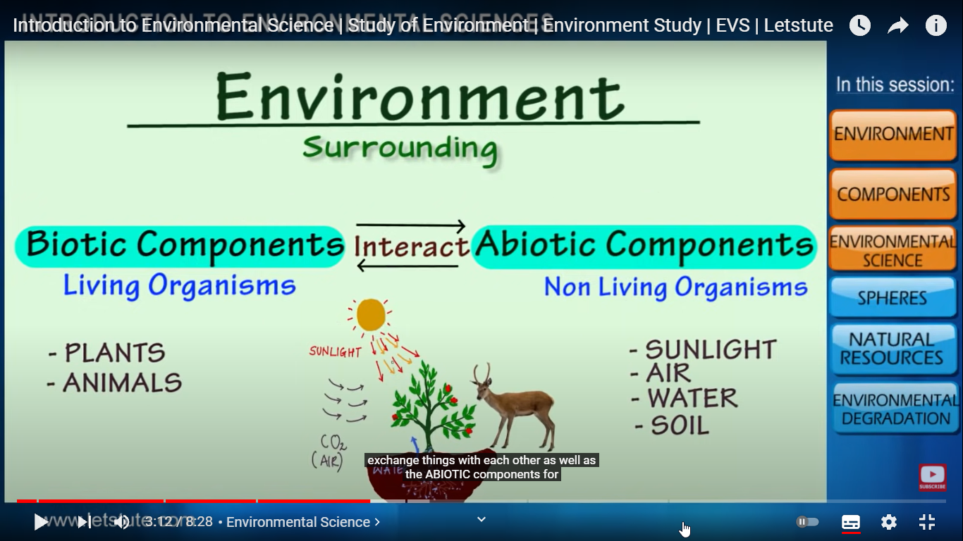
Brief Introduction about the Subject
Environmental studies are the study of human interaction with the environment and in the interests of solving complex problems.
Environment includes which we are directly or indirectly dependent for our survival, whether it is living component like animals, plants or non living component like soil, air and water.
The biologist Jacob Van Uerkal (1864-1944) introduced the term ‘environment’
Video: https://www.youtube.com/watch?v=7G3eXI_DPn8

Slide 19
Syllabus
Unit: III
UNIT-III (Biodiversity Succession)
Biodiversity and their importance, Threats to biodiversity, major causes, extinction’s, vulnerability of species to extinction, IUCN threat categories, Red data book.
Strategies for biodiversity conservation, principles of biodiversity conservation in-situ and ex-situ conservation strategies,Mega diversity zones and Hot spots, concepts, distribution and importance.
Succession: Concepts of succession, Types of Succession. Trends in succession. Climax and stability.

Slide 20
Content
Biodiversity and their importance,
Threats to biodiversity,
Major causes, extinction’s,
Vulnerability of species to extinction,
IUCN threat categories, Red data book.
Strategies for biodiversity conservation,
Principles of biodiversity conservation in-situ and ex-situ conservation strategies,
Mega diversity zones and Hot spots, concepts, distribution and importance.
Succession: Concepts of succession, Types of Succession. Trends in succession.
Climax and stability.

Slide 21
Course Objective(CO3)
Course objective of
CO 3 – To Understand the importance of biodiversity, Threats of biodiversity and different methods of biodiversity conservation (K1,K2)

Slide 22
Course Outcome(CO3)
CO 1 ---Understand the basic principles of ecology and environment. Ecosystem: Basic concepts, components of ecosystem, food chains and food webs. Ecological pyramidsK1,K2
CO 2--Understand the different types of natural recourses like food, forest, Minerals and energy and their conservation K1.K2
CO 3 --Understand the importance of biodiversity, Threats of biodiversity and different methods of biodiversity conservationK1,K2
CO 4--Understand the different types of pollution, pollutants, their sources, effects and their control methods.K1,K2,K3
CO 5--Understand the basic concepts of sustainable development, Environmental Impact Assessment (EIA) and different acts related to environmentK1,K2,K3

Slide 23
Topic wise mapping(CO3)
No | Topic | Topic outcome- Students will be able to | CO mapping | Extend of mapping
1 | Definition of biodiversity Types of biodiversity | Meaning of biodiversity,alpha,beta and gamma biodiversity | CO3 | 1
2 | Measurement of biodiversity Value of biodiversity | beta and gamma and alpha biodiversity | CO3 | 1
3 | Causes to the loss of biodiversity | Different sources and causes which are responsible to the loss of biodiversity | CO3 | 2
4 | Hot spot Conservation of biodiversity | Definition and criteria for the selection for hot spot | CO3 | 1

Slide 24
Topic wise mapping(CO3)
No | Topic | Topic outcome- Students will be able to | CO mapping | Extend of mapping
5 | Ex situ method of conservation of biodiversity | Importance of forest reserve, national parks for the conservation of biodiversity | CO3 | 1
6 | In situ method of biodiversity | Seed bank, Gene bank, tissue culture etc | CO3 | 1
7 | Definition of succession Types of ecological succession | Meaning of succession. Types and importance of succession | CO3 | 2
8 | Process of ecological succession | Process of succession | CO3 | 1

Slide 25
Prerequisite and Recap(CO3)
Basic knowledge of nature

Slide 26
Biodiversity(CO3..)
Biodiversity
It refers to the variety of living species on Earth, including plants, animals, bacteria, and fungi.
While Earth’s biodiversity is so rich that many species have yet to be discovered, many species are being threatened with extinction due to human activities, putting the Earth’s magnificent biodiversity at risk.
Biodiversity
It is a term used to describe the enormous variety of life on Earth.
It can be used more specifically to refer to all of the species in one region or ecosystem.
Biodiversity refers to every living thing, including plants, bacteria, animals, and humans.
Biodiversity, also called biological diversity, the variety of life found in a place on Earth or, often, the total variety of life on Earth.
A common measure of this variety, called species richness, is the count of species in an area.
https://en.wikipedia.org/wiki/Biodiversity

Slide 27
Biodiversity(CO3..)
Coined by Norman Myers, the term “Biodiversity hotspots” can be defined as the regions which are known for their high species richness.
Bio = Life
Diversity = Variation
Biodiversity is the variety of life on earth and the essential interdependence of all living things.
Biodiversity is defined as
“the variability among living organisms from all sources including terrestrial, marine and other aquatic ecosystems and the ecological complexes of which they are part; this includes diversity within species, between species and of ecosystems.”

Slide 28
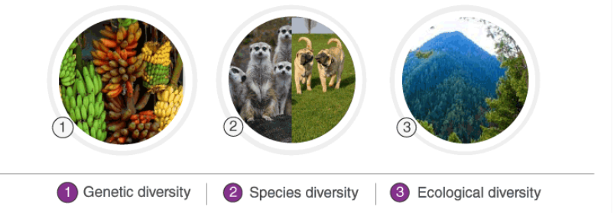
Types of biodiversity(CO3..)
Biodiversity is a measure of variation at the different level
Genetic, Species, and Ecosystem level.

Slide 29

Genetic biodiversity(CO3..)
Types of Biodiversity
There are the following three different types of biodiversity:
Genetic Biodiversity
Species Biodiversity
Ecological Biodiversity
Genetic diversity is all the different genes contained in all individual plants, animals, fungi, and microorganisms.
It occurs within a species as well as between species

Slide 30

Species biodiversity(CO3)
Species diversity refers to the variety of different types of species found in a particular area. It is the biodiversity at the most basic level.
It includes all the species ranging from plants to different microorganisms.
No two individuals of the same species are exactly similar. For example, humans show a lot of diversity among themselves

Slide 31
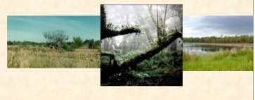
Ecological biodiversity(CO3..)
Ecosystem biodiversity is a collection of living and non-living organisms and their interaction with each other.
Ecological biodiversity refers to the variations in the plant and animal species living together and connected by food chains and food webs.
It is the diversity observed among the different ecosystems in a region.
Diversity in different ecosystems like deserts, rainforests, mangroves, etc., include ecological diversity.

Slide 32
Biodiversity at Global Level(CO3..)
Importance Of Biodiversity
Biodiversity and its maintenance are very important for sustaining life on earth.
A few of the reasons explaining the importance of biodiversity are:
Ecological Stability
Every species has a specific role in an ecosystem.
They capture and store energy and also produce and decompose organic matter.
The ecosystem supports the services without which humans cannot survive.
A diverse ecosystem is more productive and can withstand environmental stress.
Economic Importance
Biodiversity is a reservoir of resources for the manufacture of food, cosmetic products and pharmaceuticals.
Crops livestock, fishery, and forests are a rich source of food.
Wild plants such as Cinchona and Foxglove plant are used for medicinal purposes.
Wood, fibres, perfumes, lubricants, rubber, resins, poison and cork are all derived from different plant species.
The national parks and sanctuaries are a source of tourism. They are a source of beauty and joy for many people.

Slide 33
Biodiversity at Global Level(CO3..)
Ethical Importance
All the species have a right to exist.
Humans should not cause their voluntary extinction.
Biodiversity preserves different cultures and spiritual heritage.
Therefore, it is very important to conserve biodiversity.

Slide 34
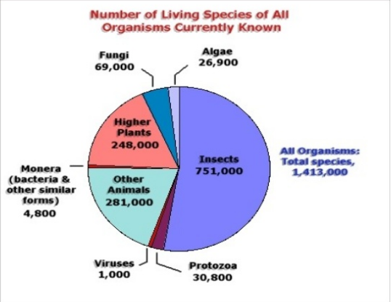
Biodiversity at Global Level(CO3..)

Slide 35
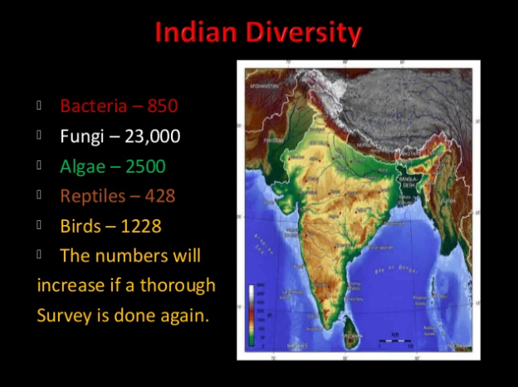
Biodiversity at National Level(CO3..)

Slide 36
Biodiversity at national level(CO3..)
Biodiversity refers to the totality of genes, species and -------- of a region.
Within a community diversity is called-----------
Western Ghats and ------- in India are among 25 hot spots of Biodiversity
Define the term biodiversity. Explain the different types of biodiversity
What are the measurements of biodiversity?
Write short note on Hot spots of Biodiversity.

Slide 37
Biodiversity Hotspots (CO3..)
Biodiversity Hotspots
2 Main Qualifying Criteria
According to Conservation International, a region must fulfill the following two criteria to qualify as a hotspot:
The region should have at least 1500 species of plants.
It must contain 30% (or less) of its original habitat, i.e. it must be threatened.
Biodiversity Hotspot,
there are major four biodiversity hotspots in India:
The Himalayas
Indo-Burma Region
The Western Ghats
Sundaland

Slide 38
Biodiversity Hotspots (CO3..)
The Himalayas
It is considered the highest in the world, the Himalayas (overall) comprises North-East India, Bhutan, Central and Eastern parts of Nepal.
This region (NE Himalayas) holds a record of having 163 endangered species which includes the Wild Asian Water Buffalo, One-horned Rhino; and as many as 10,000 plant species, of which 3160 are endemic.
This mountain range covers nearly 750,000 km².
Indo – Burma Region
The Indo-Burma Region is stretched over a distance of 2,373,000 km².
In the last 12 years, 6 large mammal species have been discovered in this region: the Large-antlered Muntjac, the Annamite Muntjac, the Grey-shanked Douc, the Annamite Striped Rabbit, the Leaf Deer, and the Saola.
This hotspot is also known for the endemic freshwater turtle species, most of which are threatened with extinction, due to over-harvesting and extensive habitat loss.
There are also 1,300 different bird species, including the threatened White-eared Night-heron, the Grey-crowned Crocias, and the Orange-necked Partridge.

Slide 39
Biodiversity Hotspots (CO3..)
The Western Ghats
The Western Ghats are present along the western edge of peninsular India and covers most of the deciduous forests and rain forests.
As per UNESCO, it is home to at least 325 globally threatened flora, fauna, bird, amphibian, reptile and fish species. Originally, the vegetation in this region was spread over 190,000 km² but has been now reduced to 43,000 km².
The region is also known for the globally threatened flora and fauna represented by 229 plant species, 31 mammal species, 15 bird species, 43 amphibian species, 5 reptile species and 1 fish species.
UNESCO mentions that “Of the total 325 globally threatened species in the Western Ghats, 129 are classified as Vulnerable, 145 as Endangered and 51 as Critically Endangered.”
Knowing in detail about the Western Ghats will be helpful for the aspirants for the Geography preparation.

Slide 40
Biodiversity Hotspots (CO3..)
Sundaland
The Sundaland hotspot lies in South-East Asia and covers Singapore, Thailand, Indonesia, Brunei, and Malaysia.
In the year 2013, the Sundaland was declared as a World Biosphere Reserve by the United Nations.
This region is famous for its rich terrestrial and marine ecosystem.
Sundaland is one of the biologically richest hotspots in the world which comprises 25,000 species of vascular plants, of which 15,000 are found only in this region.

Slide 41
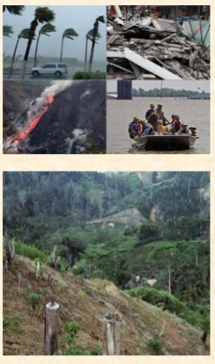
Threats to Biodiversity(CO3)
H.I.P.P.O.
There are many threats to biodiversity today. The biggest ones can be remembered by using the acronym H.I.P.P.O.:
Habitat Loss, Invasive Species, Pollution, Human Population, and Overharvesting.
Human Activities and Loss of Habitat: ...
Deforestation: ...
Desertification: ...
Marine Environment: ...
Increasing Wildlife Trade: ...
Climate Change

Slide 42
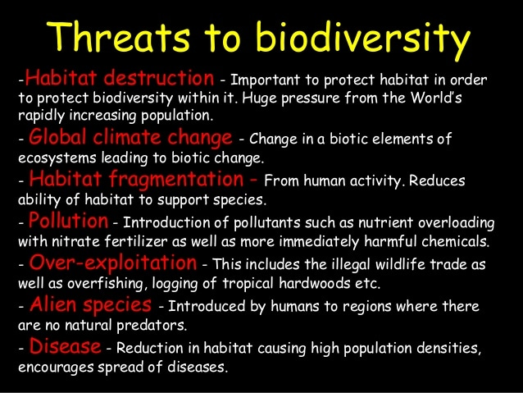
Threats to Biodiversity(CO3)

Slide 43
Threats to Biodiversity(CO3)
Some of the main threats to biodiversity are:
Human Activities and Loss of Habitat,
Deforestation,
Desertification,
Marine Environment,
Increasing Wildlife Trade and
Climate Change.
Human Activities and Loss of Habitat:
This occurs when a particular area is converted from usable to unusable habitat.
Industrial activities, agriculture, aquaculture, mining, deforestation, and water extraction are all central causes of habitat loss.
This includes deforestation for wood for cooking food.
Habitat fragmentation, the loss of large units of habitat, is also a serious threat to biodiversity.
Human activities are causing a loss of biological diversity among animals and plants globally estimated at 50 to 100 times the average rate of species loss in the absence of human activities.
Two most popular species in rich biomes are tropical forests and coral reefs.
Tropical forests are under threat largely from conversion to other land-uses, while coral reefs are experiencing increasing levels of over exploitation and pollution.

Slide 44
Threats to Biodiversity(CO3)
Biodiversity loss can result from a number of activities, including:
(a) Habitat conversion and destruction;
(b) Over-exploitation of species;
(c) Disconnected patches of original vegetation; and
(d) Air and water pollution.
Deforestation:
Forest ecosystems contain as much as 80 percent of the world’s terrestrial biodiversity and provide wood fiber and biomass energy as well as critical components of the global cycles of water, energy and nutrient.
Forest ecosystems are being cleared and degraded in many parts of the world.
Forest ecosystems contain about three times the amount of carbon currently present in the atmosphere and about one-third of this carbon is stored above ground in trees and other vegetation and two-third is stored in the soil.
When forests are cleared or burned, much of this carbon is released into the atmosphere. According to current estimates, tropical deforestation and burning account for about one quarter of carbon emissions into the atmosphere from human activities.

Slide 45
Threats to Biodiversity(CO3)
Desertification:
Desertification and deforestation are the main causes of biodiversity loss. Both processes are decisively influenced by the extension of agriculture.
The direct cost of deforestation is reflected in the loss of valuable plants and animal species.
Desertification process is the result of poor land management which can be aggravated by climatic variations.
Converting wild lands to agriculture often involves ploughing the soils which leads in temperate regions to an average decline in soil organic matter between 25 and 40 per cent over twenty five years.
Decreasing soil organic matter is always a clear indication of soil degradation, and often is accompanied by reductions in water infiltration, fertility, and ability to retain fertilizers. Ploughing also exposes soils to wind and water erosion, resulting in large-scale pollution of freshwater resources.

Slide 46
Threats to Biodiversity(CO3)
Marine Environment:
Oceans play a vital role in the global environment. Covering 70 per cent of the earth’s surface, they influence global climate, food production and economic activities.
Despite these roles, coastal and marine environment are being rapidly degraded in many parts of the globe.
In coastal areas, where human activities are concentrated, pollution, over-exploitation of resources, development of critical habitats such as wetlands, and mangroves, and water-flow from poor land-use practices have led to drastic reductions in near shore fisheries production and aquatic biodiversity.
Increasing Wildlife Trade:
According to Nick Barnes, “Trade is another cause of biodiversity depletion that gives rise to conflict between North and South.”
Global trade in wildlife is estimated to be over US $ 20 billion annually.
Global trade includes at least 40,000 primates, ivory from at least 90,000 African elephants, 1 million orchids, 4 million live birds, 10 million reptile skins, 15 million furs and over 350 million tropical fish.

Slide 47
Threats to Biodiversity(CO3)
Climate Change:
As climate warms, species will migrate towards higher latitudes and altitudes in both hemisphere.
The increase in the amount of CO₂ in the air affects the physiological functioning of plant and species composition.
Moreover, aquatic ecosystems, particularly coral reefs, mangrove swamps, and coastal wetlands, are vulnerable to changes in climate.

Slide 48
Important Definitions(CO3)
Define
Threatened species
Extinct species
Endemic species
Endangered species
Threatened species are any species (including animals, plants, fungi, etc.) which can be endangered in the near future. Species that are threatened are characterized by the population of that species.
Extinct species is a particular animal or plant species that can no longer be available as a wild, the species has died out.
3. Endemic species are those species of plants and animals which are found exclusively in a particular area.
4. An Endangered (EN) species are those species which are less in number and can be extinct in near future.

Slide 49
ENDANGERED & ENDEMIC SPECIES OF INDIA:
ENDANGERED & ENDEMIC SPECIES OF INDIA:
Species are classified into various types:
Extinct species → No longer found in the world
Endangered species → A species is said to be endangered when its no has been reduced to a critical level. Unless it is protected it is in danger of extinction.
Vulnerable species → when its population is facing continuous decline due to habitat loss.
Rare species → when it is localized within restricted area.
ENDANGERED SPECIES OF INDIA:
A species is said to be endangered when its no has been reduced to a critical level. Unless it is protected it is in danger of extinction

Slide 50
Important Endangered Species(CO3)
Important Endangered Species:
Reptiles → Tortoise, green sea turtle, gharial, python
Birds → Peacock, Siberian white crane, pelican, Indian Bustard
Mammals → Indian wolf, red fox, tiger, Indian lion, golden cat, desert cat. Primates → lion tailed monkey, capped monkey, golden monkey
Plants → medicinal plants, sandal wood tree
No of threatened species of India:
Plants 250
Birds 70
Mammals 86
Reptiles 25
Amphibians 3
Fishes 3
Mollusks 2, Insects -50

Slide 51
ENDEMIC SPECIES(CO3)
ENDEMIC SPECIES:
The species, which are found only in a particular region are known as endemic species.
62% of endemic species are found in Himalayas and Western Ghats
Fauna:
Animals present in a particular region or period is Fauna.
62% amphibians & 50% lizards are endemic to Western Ghats.
(ex) Monitor lizards, reticulated python, Indian salamander, viviparous toad.
Flora:
Plants present in a particular region or period is Flora
(ex) Sapria himalayana, ovaria lurida, pteridophyta, angiosperms etc

Slide 52
The IUCN Red List(CO3)
The IUCN ( International Union for Conservation of Nature) Red List
It is Founded in 1964, the IUCN Red List also known as the Red Data List evaluates the biological species in the world which are at the risk of extinction.
IUCN aims to focus on the conservation of the world’s species to reduce species extinction.
More than 77,300 species have been assessed on the IUCN Red List.
The IUCN Red List can be divided into the following 9 categories:
Extinct (EX) – No known individuals remaining.
Extinct in the wild (EW) – Known only to survive in captivity, or as a naturalized population outside its historic range.
Critically endangered (CR) – Extremely high risk of extinction in the wild.
Endangered (EN) – High risk of extinction in the wild.
Vulnerable (VU) – High risk of endangerment in the wild.
Near threatened (NT) – Likely to become endangered shortly.
Least concern (LC) – Lowest risk. Does not qualify for a more at-risk category. Widespread and abundant taxa are included in this category.
Data deficient (DD) – Not enough data to assess its risk of extinction.
Not evaluated (NE) – Has not yet been evaluated against the criteria

Slide 53
Conservation of biodiversity(CO3)
Types of Conservation of biodiversity :
In-situ conservation (within habitat)
Ex-situ conservation (outside habitat)
IN-SITU CONSERVATION:
Involves protection of fauna & flora within its natural habitat
Biosphere Reserves:
Biosphere Reserve (BR) is an international designation by UNESCO for representative parts of natural and cultural landscapes extending over large area of terrestrial or coastal/marine ecosystems or a combination thereof.
BRs are designated to deal with one of the most important questions of reconciling the conservation of biodiversity, the quest for economic and social development and maintenance of associated cultural values.
BRs are thus special environments for both people and the nature and are living examples of how human beings and nature can co-exist while respecting each others’ needs.
Covers area of more than 5000 sq. km.
Protect species for long time

Slide 54
Conservation of biodiversity(CO3)
1 | Nilgiri Biosphere Reserve | Tamil Nadu, Kerala and Karnataka | 2000
2 | Gulf of Mannar Biosphere Reserve | Tamil Nadu | 2001
3 | Sundarbans Biosphere Reserve | West Bengal | 2001
4 | Nanda Devi Biosphere Reserve | Uttarakhand | 2004
5 | Nokrek Biosphere Reserve | Meghalaya | 2009
6 | Pachmarhi Biosphere Reserve | Madhya Pradesh | 2009
7 | Simlipal Biosphere Reserve | Odisha | 2009
8 | Great Nicobar Biosphere Reserve | Andaman & Nicobar Islands | 2013
9 | Achanakmar-Amarkantak Biosphere Reserve | Chhattisgarh, Madhya Pradesh | 2012
10 | Agasthyamalai Biosphere Reserve | Kerala and Tamil Nadu | 2016
11 | Khangchendzonga National Park | Sikkim | 2018
12 | Panna Biosphere Reserve | Madhya Pradesh | 2020

Slide 55
Conservation of biodiversity(CO3)
Role of Biosphere reserves:
Protects endangered species
Site of recreation & tourism
Useful for education & research purpose
Gives long term survival
Restriction:
No tourism & explosives are permitted.

Slide 56
Conservation of biodiversity(CO3)
National Park:
National park is an area which is strictly reserved for the betterment of the wildlife and biodiversity, and where activities like developmental, forestry, poaching, hunting and grazing on cultivation are not permitted.
The government can declare an area as a national park with adequate ecological, geo-morphological and natural significance.
In these parks, even private ownership rights are not allowed.
Their boundaries are well marked and circumscribed. They are usually small reserves spreading in an area of 100 sq. km. to 500 sq. km.
Conserve Plants
Examples:
Citrus sanctuary – North India
Pitcher plant -North India
https://www.careerpower.in/national-parks-india.html

Slide 57
Conservation of biodiversity(CO3)
Wildlife Sanctuaries:
A Wildlife Sanctuary is a protected area of importance for flora, fauna, or features of geological or other interest, which is reserved and managed for conservation and to provide opportunities for study or research.
The Wild Life (Protection) Act, 1972 provides for the establishment of Protected Areas in India
Conserve animals & Birds only
(Examples)
Mudumalai wildlife sanctuary –TN
Vedanthangal Lake Bird sanctuary- TN
Sultanpur Bird sanctuary - Haryana
Ghana Bird sanctuary - Rajasthan
Wild Ass sanctuary -Gujarat
Role of wildlife Sanctuaries: Protects animals only Harvesting of timber, Collection of forest products
https://en.wikipedia.org/wiki/List_of_wildlife_sanctuaries_of_India

Slide 58
Conservation of biodiversity(CO3)
Other Projects for conservation of animals:
Examples:
Gir Lion Project, Crocodile Breeding Project, Project Elephant, Project Tiger etc.
Merits of In-situ conservation:
Very cheap & convenient method
Species adjust to floods, drought, forest fires etc.
Demerits
Large area is needed, Maintenance is not proper due to pollution and lack of staff

Slide 59
Ex situ conservation of Biodiversity(CO3)
Definiton
Ex-situ conservation literally means, "off-site conservation".
It is the process of protecting an endangered species of plant or animal by removing part of the population from a threatened habitat and placing it in a new location, which may be a wild area or within the care of humans.
While ex-situ conservation comprises some of the oldest and best known conservation methods, it also involves newer, sometimes controversial laboratory methods.
Such strategies include establishment of
Botanical gardens,
Zoos,
Conservation strands and gene,
Pollen seed,
Seedling, tissue culture and DNA banks.

Slide 60
Merit and demerit of Ex situ conservation(CO3)
Merits
Survival / life span of species increase by special care Species are assured for food, water, shelter etc Endangered species are preserved
Demerits:
Expensive method Freedom of wildlife is lost
Animal cant survive in natural environment

Slide 61
Ex situ conservation of Biodiversity (CO3)
Difference between “In-situ Conservation” and “Ex-situ Conservation”:
In situ Conservation:
It is conservation of endangered species in their natural habitats.
The endangered species are protected from predators.
The depleting resources are augmented.
The population recovers in natural environment.
Ex situ Conservation:
It is conservation of endangered species outside their natural habitats.
The endangered species are protected from all adverse factors.
They are kept under human supervision and provided all the essentials.
Offspring produced in captive breeding are released in natural habitat for acclimatization.
https://www.hindawi.com/journals/isrn/2013/985037/

Slide 62
Megadiversity Zones (CO3)
The term megadiverse country refers to any one of a group of nations that harbor the majority of Earth's species and high numbers of endemic species.
Conservation International identified 17 megadiverse countries in 1998.
Many of them are located in, or partially in, tropical or subtropical regions.
Brazil, China, Colombia, Costa Rica, India, Indonesia, Kenya, Mexico, Peru, the Philippines, South Africa and Venezuela etc.
India is one of the 12 mega biodiversity countries in the world.
Hot spots in India
The Himalayas,
The Western Ghats,
The Indo-Burma region
The Sundaland.
The Sundarbans and
The Terrai-Duar Savannah grasslands

Slide 63
Megadiversity Zones (CO3)
Biosphere Reserves in India
There are 18 biosphere reserves in India:
Cold Desert, Himachal Pradesh
Nanda Devi, Uttrakhand
Khangchendzonga, Sikkim
Dehang-Debang, Arunachal Pradesh
Manas, Assam
Dibru-Saikhowa, Assam
Nokrek, Meghalaya
Panna, Madhya Pradesh
Pachmarhi, Madhya Pradesh
Achanakmar-Amarkantak, Madhya Pradesh-Chhattisgarh
Kachchh, Gujarat (Largest Area)

Slide 64
Megadiversity Zones (CO3)
Sundarban, West Bengal
Seshachalam, Andhra Pradesh
Agasthyamala, Karnataka-Tamil Nadu-Kerala
Nilgiri, Tamil Nadu-Kerala (First to be Included)
Gulf of Mannar, Tamil Nadu
Great Nicobar, Andaman & Nicobar Island
National Parks:
There are 106 existing national parks in India covering an area of 43,716 km2, which is 1.33% of the geographical area of the country (National Wildlife Database, Dec. 2020).
In addition to the above 75 National Parks covering an area of 16,608 km2 are proposed in the Protected Area Network Report (Rodgers & Panwar, 1988).
https://en.wikipedia.org/wiki/List_of_national_parks_of_India

Slide 65
Megadiversity Zones (CO3)
Wildlife Sanctuaries:
A Wildlife Sanctuary is a protected area of importance for flora, fauna, or features of geological or other interest, which is reserved and managed for conservation and to provide opportunities for study or research.
The Wild Life (Protection) Act, 1972 provides for the establishment of Protected Areas in India
Conserve animals & Birds only
(Examples)
Mudumalai wildlife sanctuary –TN
Vedanthangal Lake Bird sanctuary- TN
Sultanpur Bird sanctuary - Haryana
Ghana Bird sanctuary - Rajasthan
Wild Ass sanctuary -Gujarat
Role of wildlife Sanctuaries: Protects animals only Harvesting of timber, Collection of forest products
https://en.wikipedia.org/wiki/List_of_wildlife_sanctuaries_of_India

Slide 66
Megadiversity Zones (CO3)
Biogeographic zones
India has been devided into ten recognizable biogeographic zones as follows:
Trans-Himalayan Region
Himalayan Zone
Indian Desert Zone
Semi Arid Region
Western Ghats
Deccan Plateau
Gangetic Plain
North East Region
Coastal Region
Andaman and Nicobar Islands
https://www.gktoday.in/topic/biogeographic-regions-of-india/

Slide 67
Value of biodiversity(CO3)
Value of biodiversity:
Some of the major values of biodiversity are as follows: 1. Environmental Value 2. Social Value 3. Ecosystem Services 4. Economic Value 5. Consumptive use value 6. Productive Use Value 7. Ethical and Moral Value 8. Aesthetic Value.
Direct values These are those ways by which we can directly use biodiversity for our benefit. For example we can use plants as food of for deriving medicines in the laboratory. Economic value and recreational value comes under this category. Direct values are further classified into:
• Consumptive use Value: Consumptive use value is the value put on the products of nature which are consumed directly without passing through a market. For example, if we use firewood by cutting down a tree or consume an animal after hunting it.
• Productive use value: Productive use value is the value put on the products of nature which are consumed after passing through a market. For example, if we buy fish from the market then it will have productive use value.

Slide 68
Value of biodiversity(CO3)
Indirect values or Non-Consumptive value
These are those ways by which we don't physically use a plant or animal, but by virtue of its existence it provides services that keep the ecosystem healthy.
Indirect values would include
Ethical or moral value,
Existence value,
Ecological value,
Aesthetic value,
Cultural or spiritual value,
Option value and
Scientific or educational value
Social values
Social value of biodiversity lies in the more and more use of resources by affluent societies.
Apart from traditional agricultural systems, in recent years, farmers have begun to receive economic incentives to grow each crop for national or international markets rather than to supply local needs.
This has resulted in local food shortages, unemployment, landlessness and increased tendency to drought and floods.

Slide 69
Value of biodiversity(CO3)
Ethical and Moral value
Every species has its moral right to exist on earth. Every human culture, religion and society has its own ethical values.
There are several cultural, moral and ethical values, which are associated with the conservation of biodiversity.
We have in our country a large number of sacred grooves or deolis preserved by tribal people in several States.
These sacred groves around ancient sacred sites and temples act as gene banks for wild plants.
Economical value
Biodiversity has economic value because it is a source of important products. Some of these products are :
• Food supplies: Agriculture, the very basis of human survival, depends on plants and animals.
• Source of medicines: A large number of medicines are obtained from plants and animals. Cinchonas, Belladonna are important medicinal plants. Snake venom is used in making medicines.
• Source of raw materials for industries. • It supports the economy of a country. Industries and agriculture generate revenue or income.
They also generate employment. In fact the economy of many countries is heavily dependent on biodiversity..

Slide 70
Value of biodiversity(CO3)
Aesthetic value
Nature contributes immensely to the beauty of the world. Can you imagine a world without trees, grass, flowers, birds or animals? Thus, biodiversity has immense aesthetic value for us.
Ecological value
Every species plays a unique role in the ecosystem.
Through this role its maintains the ecological balance.
The ecological services maintain ecological balance and the ecosystem.
Some of these services are:
Waste Management: Nature has a unique way of managing wastes. The waste of one organism becomes food for another organism. So, wastes don't accumulate.
For example, forests absorb greenhouse gases like carbon dioxide during photosynthesis.
This helps to reduce global warming.
Forests also contribute to precipitation due to transpiration.
Many other plants and animals help to keep forests healthy.
So, the entire biodiversity contributes towards maintaining climate stability.

Slide 71
Value of biodiversity(CO3)
Scientific value or Educational value
Biodiversity is of great scientific value.
Many species of plants and animals are the subjects of our research.
We use many species for research and in turn get a lot of knowledge from their study.
Through research on plants, insects and animals we find better ways of making medicines, hybrid plants, engineering designs and many other things that are of immense value to human beings.
For example, the design of Velcro is developed from cockle-burrs which cling fast to clothing as we walk in the woods.

Slide 72
Value of biodiversity(CO3)
Cultural and Spiritual value
Many cultures of human beings are closely related to many species of plants and animals.
For example, Hindus Identify owls as the transport of Goddess Lakshmi. Many religions identify themselves with such plants and animals which renders to them a cultural or spiritual value.
Option value
There are many plants and animals which have not yet been discovered or even if they have been discovered we do not know if they can be of any use to us.
This untapped potential is referred to as option value.
For example, there might be a plant or animal which we can use in the future to find a cure for corner.
If we destroy biodiversity then we lose this chance of finding a cure for cancer. Thus biodiversity has great potential of being useful to us in the future.

Slide 73
Ecological succession(CO3)
Ecological succession
It is the process of change in the species structure of an ecological community over time.
The time scale can be decades (for example, after a wildfire), or even millions of years after a mass extinction.
The "engine" of succession, the cause of ecosystem change, is the impact of established organisms upon their own environments.
A consequence of living is the sometimes subtle and sometimes overt alteration of one's own environment.
Two different types of succession
Primary succession
Secondary succession

Slide 74
Ecological succession(CO3)
Primary Succession
Primary succession is the succession that starts in lifeless areas such as the regions devoid of soil or the areas where the soil is unable to sustain life.
When the planet was first formed there was no soil on earth. The earth was only made up of rocks. These rocks were broken down by microorganisms and eroded to form soil. The soil then becomes the foundation of plant life. These plants help in the survival of different animals and progress from primary succession to the climax community.
If this primary ecosystem is destroyed, secondary succession takes place.

Slide 75
Ecological succession(CO3)
Secondary succession
It occurs when the primary ecosystem gets destroyed
. For eg., a climax community gets destroyed by fire. It gets recolonized after the destruction.
This is known as secondary ecological succession. Small plants emerge first, followed by larger plants.
The tall trees block the sunlight and change the structure of the organisms below the canopy. Finally, the climax community arrives.

Slide 76
Ecological succession(CO3)
A seral community is an intermediate stage of ecological succession advancing towards the climax community.”
A seral community is replaced by the subsequent community.
It consists of simple food web and food chains. It exhibits a very low degree of diversity. The individuals are less in number and the nutrients are also less.
https://en.wikipedia.org/wiki/Ecological_succession
https://www.britannica.com/science/ecological-succession

Slide 77
Types of Seres(CO3)
Types of Seres
Hydrosere
Succession in aquatic habitat.
Xerosere
Succession in dry habitat

Slide 78
Types of Seres(CO3)
Lithosere
Succession on a bare rock surface.
Psammosere
Succession initiating on sandy areas.
Halo sere
Succession starting in saline soil or water.
Senile
Succession of microorganism on dead matter.
Eosere
Development of vegetation in an era.

Slide 79
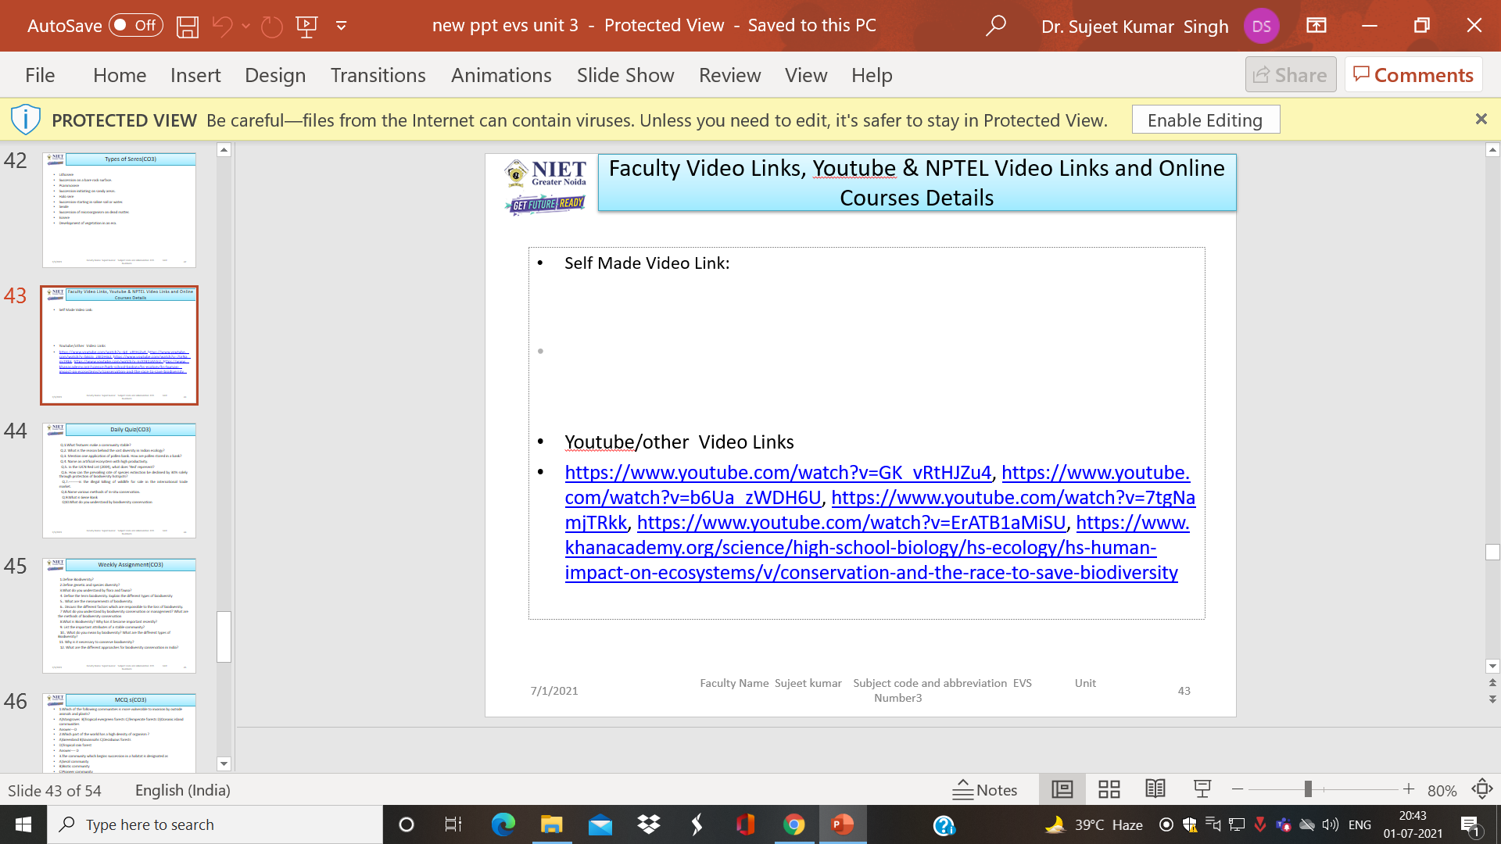
Faculty Video Links, Youtube & NPTEL Video Links and Online Courses Details
Self Made Video Link:
Youtube/other Video Links
https://www.youtube.com/watch?v=GK_vRtHJZu4, https://www.youtube.com/watch?v=b6Ua_zWDH6U, https://www.youtube.com/watch?v=7tgNamjTRkk, https://www.youtube.com/watch?v=ErATB1aMiSU, https://www.khanacademy.org/science/high-school-biology/hs-ecology/hs-human-impact-on-ecosystems/v/conservation-and-the-race-to-save-biodiversity

Slide 80
Daily Quiz(CO3)
Q.1.What features make a community stable?
Q.2. What is the reason behind the vast diversity in Indian ecology?
Q.3. Mention one application of pollen bank. How are pollen stored in a bank?
Q.4. Name an artificial ecosystem with high productivity.
Q.5. In the IUCN Red List (2004), what does ‘Red’ represent?
Q.6. How can the prevailing rate of species extinction be declined by 30% solely through protection of biodiversity hotspots?
Q.7.---------is the illegal killing of wildlife for sale in the international trade market.
Q.8.Name various methods of In-situ conservation.
Q.9.What is Gene Bank
Q10.What do you understand by biodiversity conservation

Slide 81
Weekly Assignment(CO3)
1.Define Biodiversity?
2.Define genetic and species diversity?
3.What do you understand by flora and fauna?
4. Define the term biodiversity. Explain the different types of biodiversity
5.. What are the measurements of biodiversity.
6.. Discuss the different factors which are responsible to the loss of biodiversity.
7 What do you understand by biodiversity conservation or management? What are the methods of biodiversity conservation
8.What is Biodiversity? Why has it become important recently?
9. List the important attributes of a stable community?
10.. What do you mean by biodiversity? What are the different types of Biodiversity?
11. Why is it necessary to conserve biodiversity?
12. What are the different approaches for biodiversity conservation in India?

Slide 82
MCQ s(CO3)
1.Which of the following communities is more vulnerable to invasion by outside animals and plants?
A)Mangroves B)Tropical evergreen forests C)Temperate forests D)Oceanic island communities
Answer---D
2.Which part of the world has a high density of organism ?
A)Greenland B)Savannahs C)Deciduous forests
D)Tropical rain forest
Answer---- D
3.The community which begins succession in a habitat is designated as
A)Seral community
B)Biotic community
C)Pioneer community
D)Ecosere
Answer-----C

Slide 83
MCQ s(CO3)
4.Which of the following is not a colonizer ?
A)Blue-green algae B)Viruses C)Lichens D)Mosses Answer---B
5.A succession exhibiting changes in the communities at a place is described as
A)Biotic succession B)Physiographic succession C)Climatic succession D)Geographic succession
Ans--D
6.The nature of a climax community depends upon
A)Water factor
B)Temperature
C)Soil fertility
D)Climate
Answer C

Slide 84
MCQ s(CO3)
7.The earliest settlers on barren lands generally are
A)Diatoms B)Ferns C)Mosses D)Lichens
Answer--C
8.The last community in a succession is called
A)Ecosystem B)Climax community C)Ecotone D)Seral community
Answer--B
9.Plant succession taking place in sandy area is called
A)Halosere B)Psammosere C) XerosereD) Hydrosere
Answer---B
10The physiographic factor responsible for the initiation of succession to
A)Erosion
B)c)Fire
C)Hail
D)Wind
Answer D

Slide 85
Old Question Papers
NEW AUTONOMOUS SYLLABUS

Slide 86
Expected Questions for University Exam(CO3)
1.There are many animals that have become extinct in the wild but continue to be maintained in zoological parks.
2.White Bengal tigers are protected in special settings in zoological parks. Tiger reserves are maintained in Western Ghats.How do these two approaches differ from each other? Mention the advantages of each one.
3. Why is there a need to conserve biodiversity?
4. Name and explain any two ways that are responsible for the loss of biodiversi
5. What is the difference between in-situ & ex-situ conservation
6. “Amazonian rain forest in south America has the greatest bio-diversity on earth”. Justify the statement
7. What do you mean by species diversity? Name two measures of species diversity statement with the help of an example?
8.. What are sacred grooves? What is their role in conservation? What do you mean by IPR. What are the drawbacks of IPR.
9. What is Biodiversity? Why has it become important recently?
10. List the important attributes of a stable community?

Slide 87
Summary(CO3)
. Definition: The variety and variability among all groups of living organisms and the ecosystem in which they occur.
Levels/Classification of Biodiversity:
Genetic diversity → Diversity within the species is genetic diversity.(ex) teak wood varieties, Indian, Burma, malasian
Species diversity→ diversity between different species. (ex) plant species = apple, mango, grapes, animal species = lion, tiger, elephant etc.
Community/Ecosystem diversity → Diversity at the ecological or habitat level is ecosystem diversity. Ex. River ecosystem.

Slide 88
Summary(CO3)
Process of Ecological Succession
Nudation
Invasion → Migration, Establishment Competition
Reaction Stabilization
The progressive replacement of one community by another till the development of stable community in a particular area is ecological succession. Stages of ecological succession:
Pioneer community → first group of organism in an area Seral stage → various developmental stages of community Types of ecological succession:
Primary succession → involves gradual establishment of biotic communities on a lifeless ground Hydrarch / Hydrosere → establishment starts in watery area like pond and lake
Xerarch / Xerosere → establishment starts in a dry area like desert and rock

Slide 89
Reference Books
.1. Sodhi G.S. 2005, Fundamentals of Environmental Chemistry: Narosa Publishing House, New Delhi.
2. Dash, M.C. (1994).Fundamentals of Ecology, Tata McGraw Hill, New Delhi.
3. Sharma P. D. (1996). Environmental Biology, Rastogi Publications, Meerut.
4. Verma P.S. and V.K. Agarwal. (1985). Principles of Ecology. S. Chand and Company (Pub.), New Delhi.
5. Principles of Environmental Sciences and Engineering -P. Venugoplan Rao, Prenitice Hall of India.
6. Environmental Science and Engineering Meenakshi, Prentice Hall India

Slide 90
Noida Institute of Engineering and Technology, Greater Noida
Thank You
https://www.youtube.com/watch?v=ewJ96jiwHn0
https://www.youtube.com/watch?v=bm0U8XRbDVY
https://www.youtube.com/watch?v=viQFIGTiUBo
https://www.youtube.com/watch?v=RjHtvV_0Fh4(biodiversity)
https://www.youtube.com/watch?v=7Ecczi9qVSM

